Slide 1
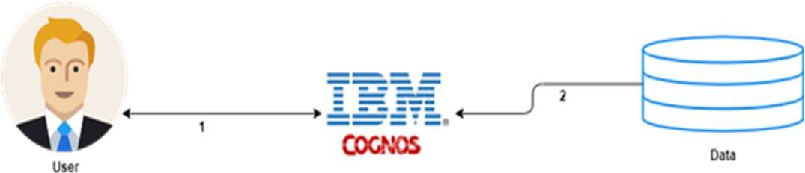
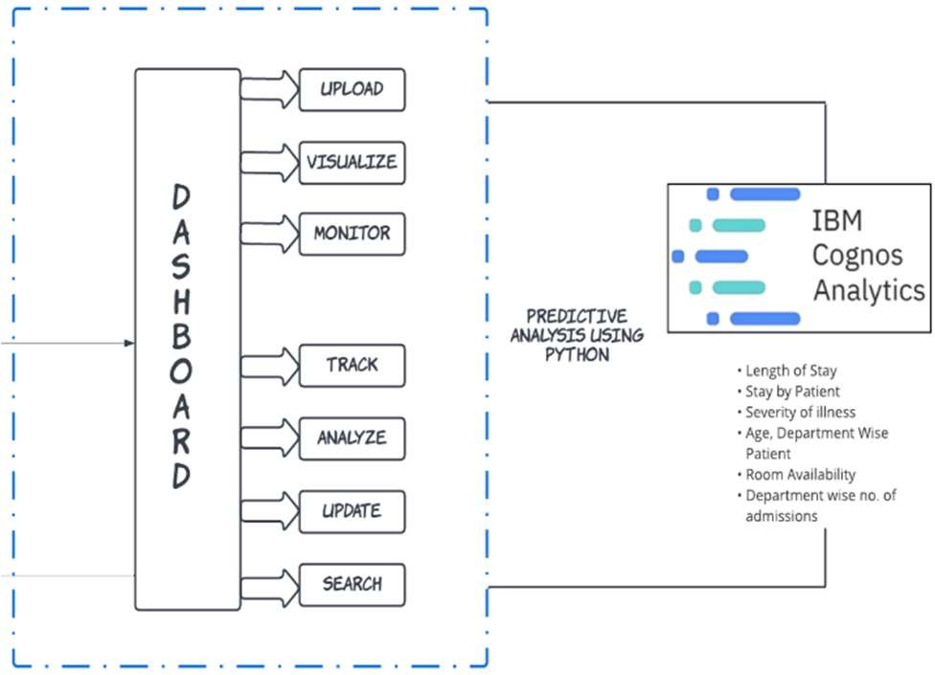


Project Design Phase-I Solution Architecture
Project Design Phase(Solution Architecture)
Project Name:Analytics For Hospitals healthCare Data
Solution Architecture:
Solution architecture is a complex process – with many sub-processes – that bridges the gap between patient, healthcare management and technology solutions. Its goals are to:
Accurately predict the Length of Stay for each patient on case-by-case basis
So that the Hospitals can use this information for optimal resource allocation and better functioning.
Information like the patient's disease, length of stay period, doctor’s suggestion, Age, Department wise patient, room availability, medicine availability.
Example - Solution Architecture Diagram :
H E A L T H C A R E
M A N A G E M E N T
Client Side
Analysing and Prediction

